Slide 1
Setting up Microsoft Azure Machine Learning

Slide 2
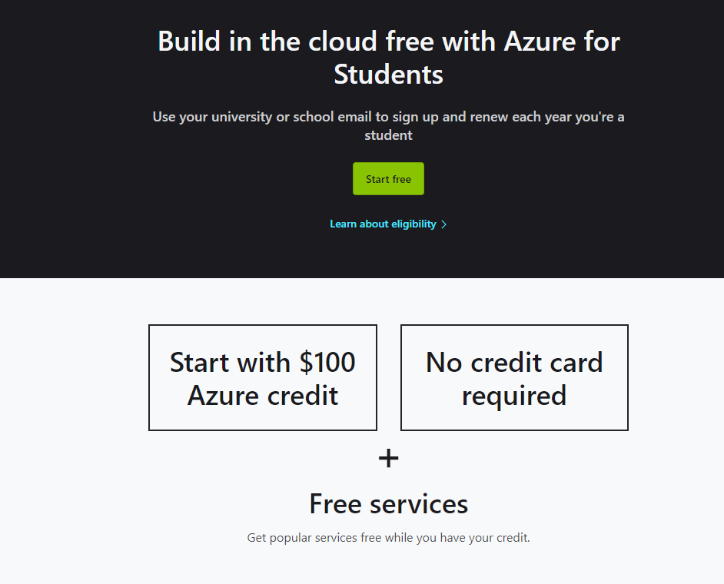
Register for an Azure Student Account
Please visit https://azure.microsoft.com/en-us/free/students/ then follow the instructions
Click on Start free

Slide 3
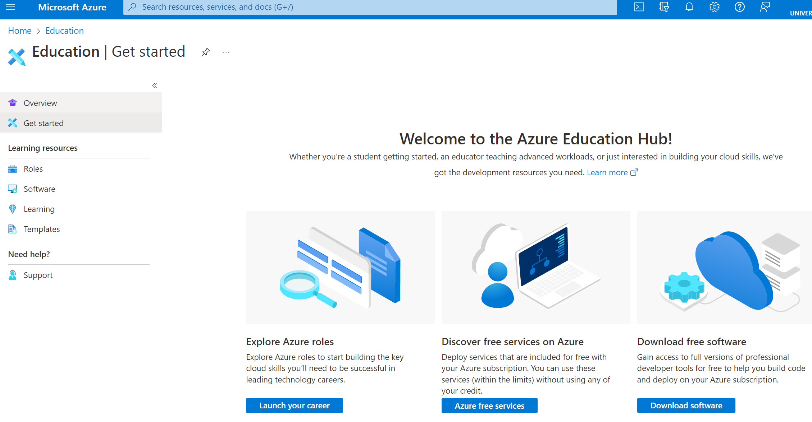
Azure Education Hub
After following all steps to create your student account, you should be redirected to the Azure Education Hub

Slide 4
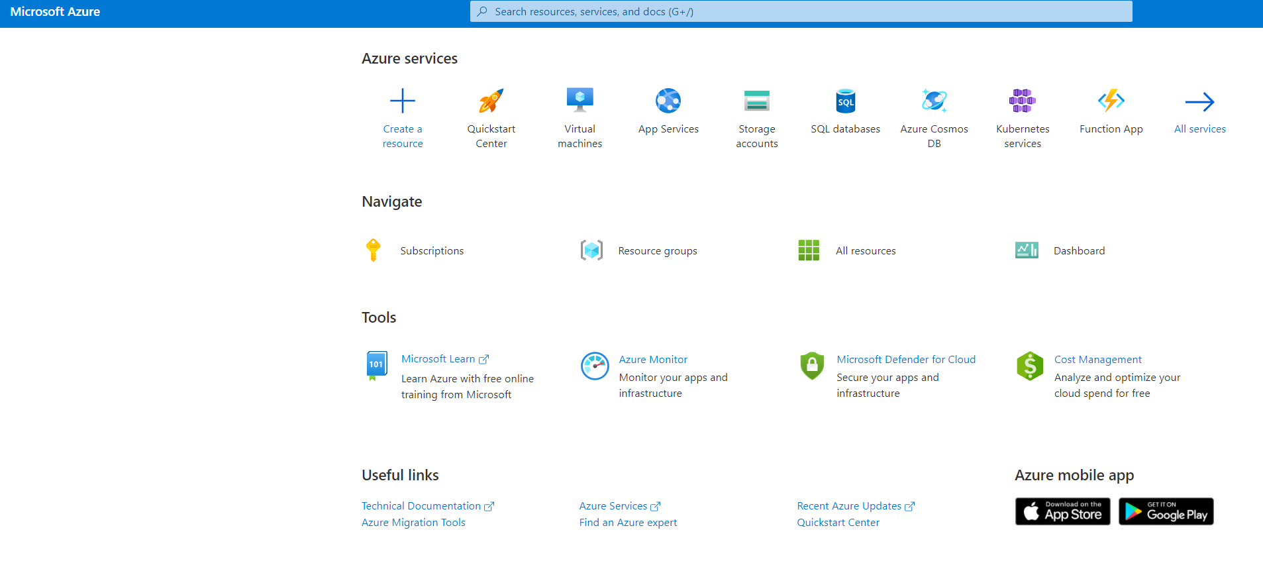
Create New Resources
Click on the Microsoft Azure link on the top left to be redirect to the console page
Then click on Create a resource

Slide 5
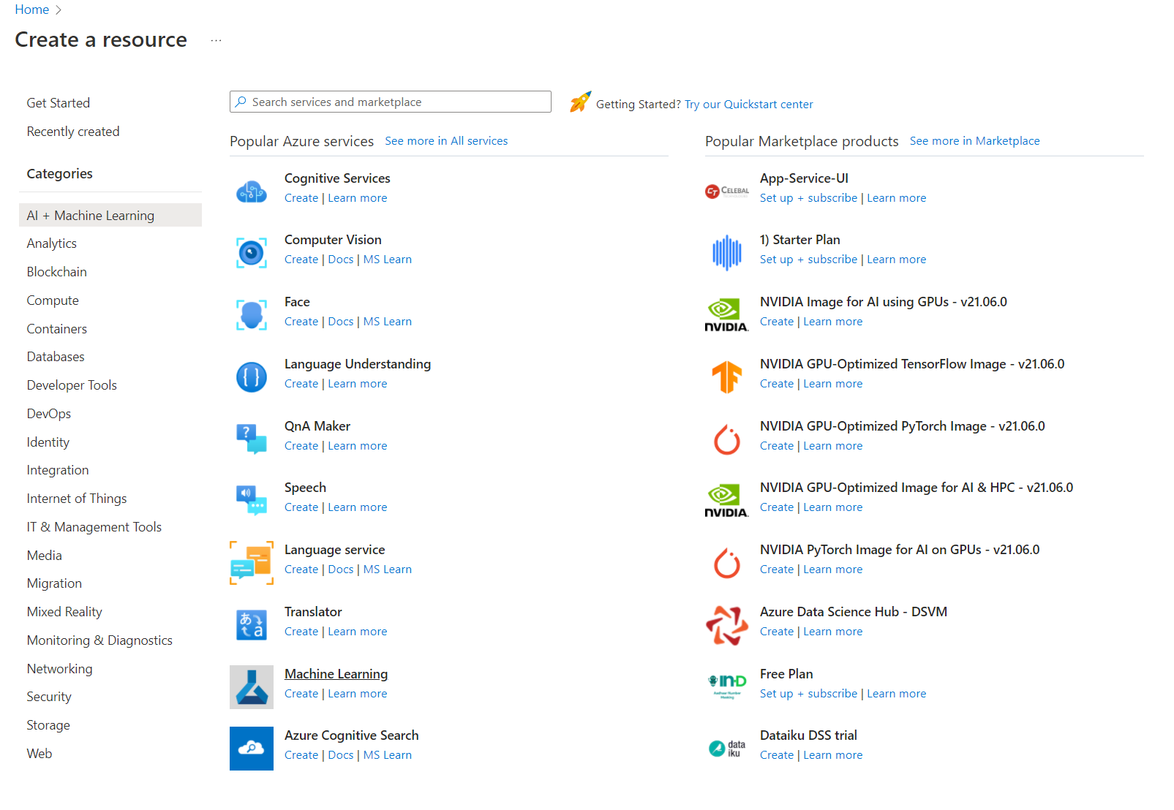
Machine Learning Resource
Select AI + Machine Learning on the left side, then select Machine Learning

Slide 6
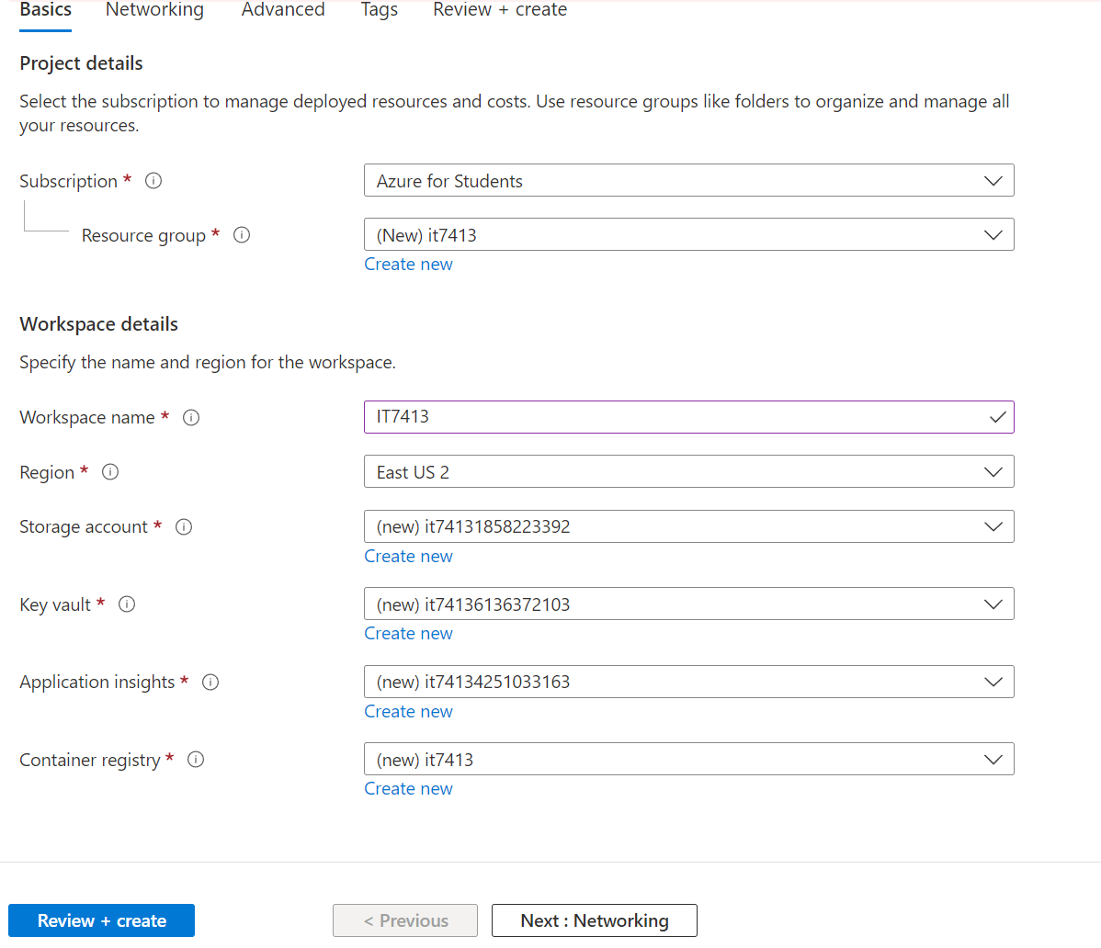
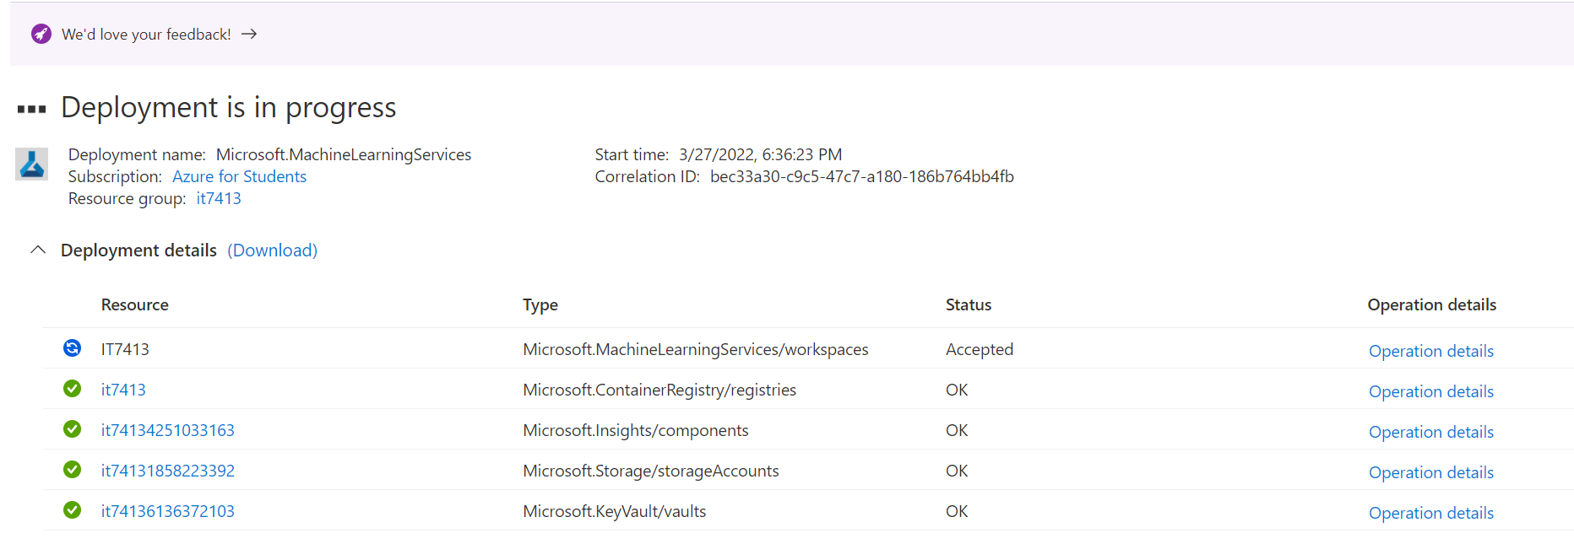
Resource Information
Fill in the information for the resource
You will have to create new for some of the information
After filling everything, click Review + create
The resource will then be deploying

Slide 7
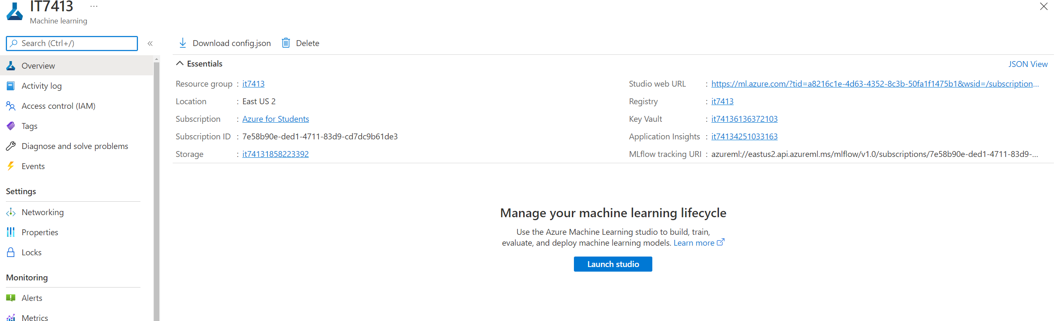
Deployed Resource
After the resource is deployed, click on Launch studio

Slide 8
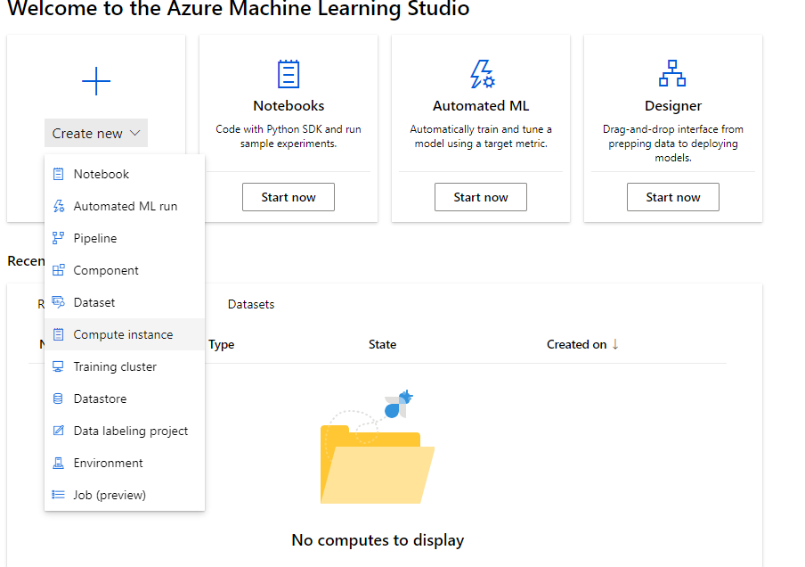
Create a Compute Instance
Create a new Compute instance so we can begin using Jupyter notebook

Slide 9
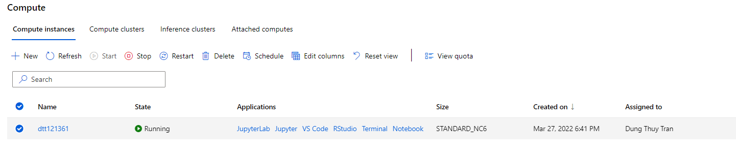
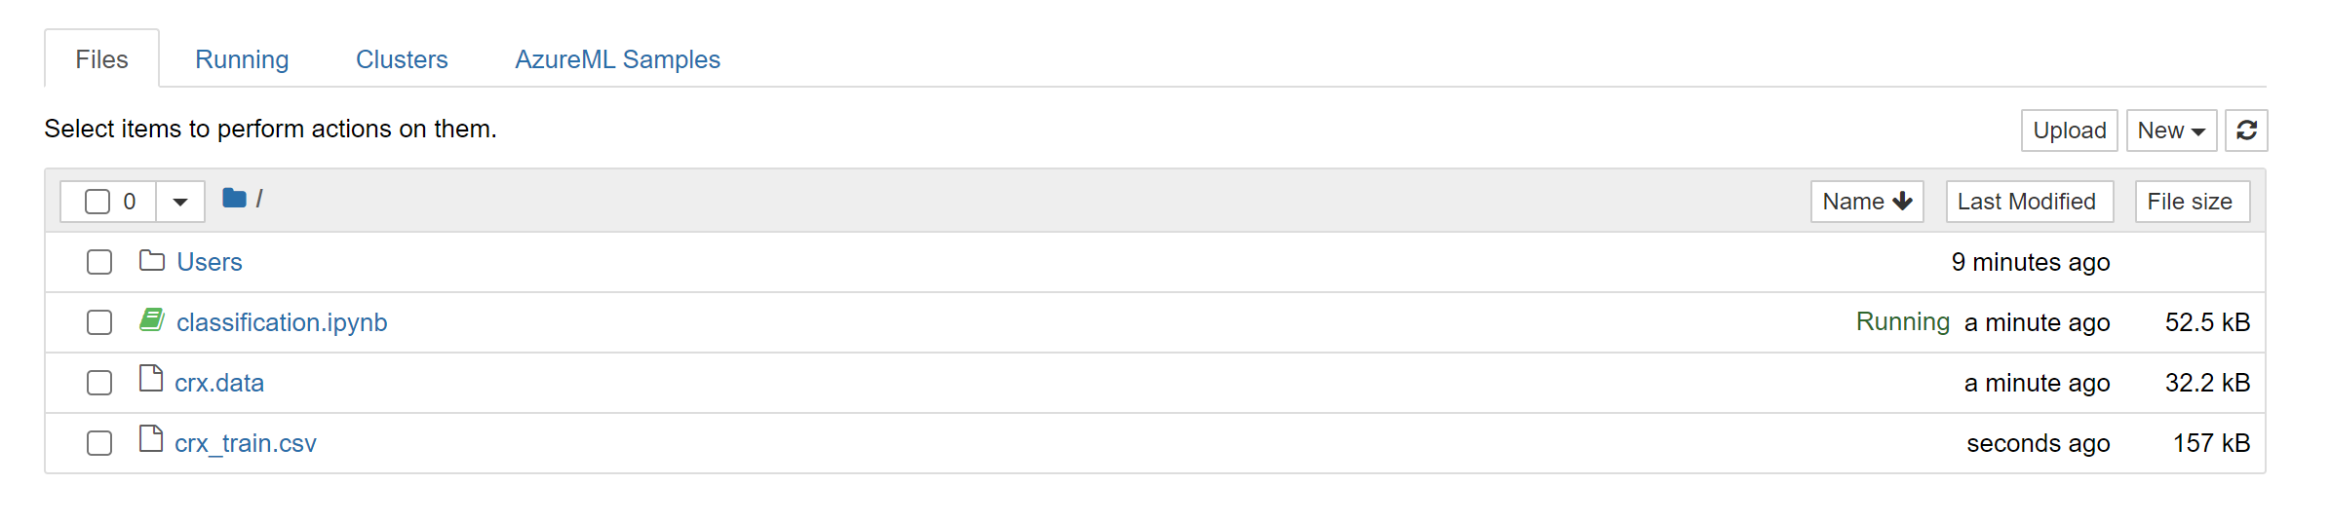
Access Jupyter Notebook
After the compute instance is ready, you can click on Jupyter to be redirected to Jupyter notebook environment
You can upload our previous notebooks and data here. All codes except for AWS models should run without problems.

Slide 10
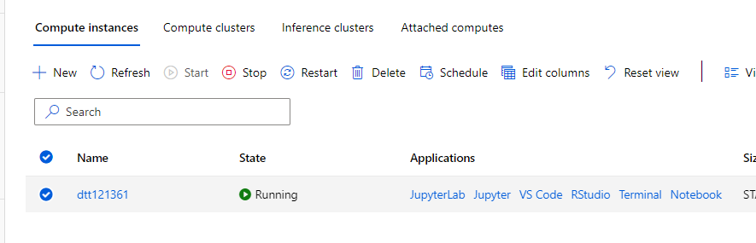
Stopping the Instance
After finishing all tasks, remember to stop your instance to avoid unnecessary charges

Slide 11
Additional Reading
Billing alert for Azure
https://docs.microsoft.com/en-us/azure/cost-management-billing/costs/cost-mgt-alerts-monitor-usage-spending

